Slide 1

Fundamentals of
Electric Circuit
2020.4
Chapter 7
First-Order Circuits

Slide 2
Chapter 7 First-Order Circuits
7.0 Introduction
7.1 The Source-Free RC Circuit
7.2 The Source-Free RL Circuit
7.3 Unit-Step Function
7.4 The Step-Response of a RC Circuit
7.5 The Step-Response of a RL Circuit

Slide 3
7.0 introduction
In this chapter, we will focus on circuits that consist only of sources, resistors, and either (but not both) inductors or capacitors.
We call them as RC (resistor-capacitor) circuits and RL (resistor-inductor) circuits.
Method: Kirchhoff’s laws.
Difference: algebraic equations(Resistive corcuit)
differential equations(RC,RL circuit).
first order differential equations
first-order circuits.

Slide 4
7.0 introduction
A first-order circuit is characterized by a first-order differential equation.
Any circuit with
a single energy storage element（C or L）
an arbitrary number of sources
an arbitrary number of resistors
is a circuit of order 1.
Two ways to excite the circuits:
Initial conditions: energy stored in the capacitive or inductive element. (Source-free)
Independent sources

Slide 5


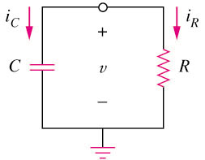
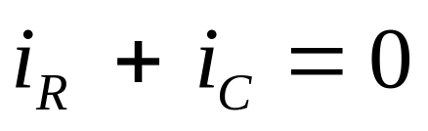
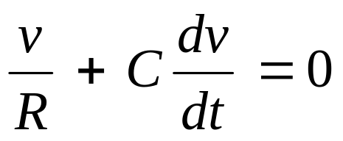
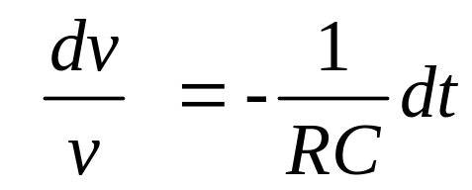
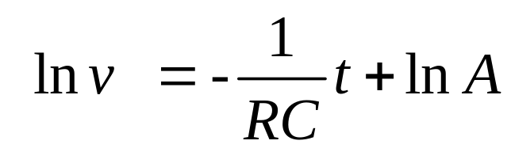
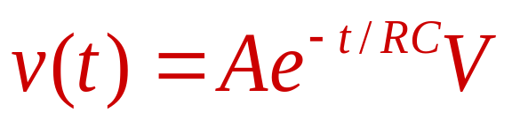
7.1 The Source-Free RC Circuit
By KCL
Ohms law
Capacitor law
Rearrange the terms as
Integrating both sides gives
Take powers of e produces

Slide 6
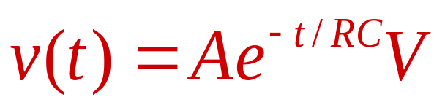
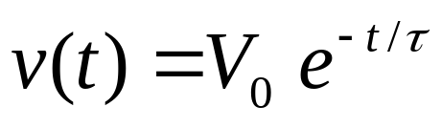

where
The response is due to the initial energy stored and the physical characteristics of the circuit and not due to some external voltage or current source, it is called the natural response of the circuit.
The key to working with a source-free RC circuit is finding:
The initial voltage v(0) = V₀ across the capacitor.
The time constant τ = RC.

Slide 7
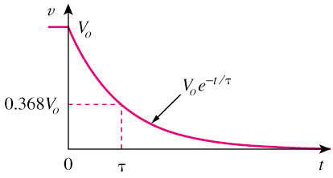
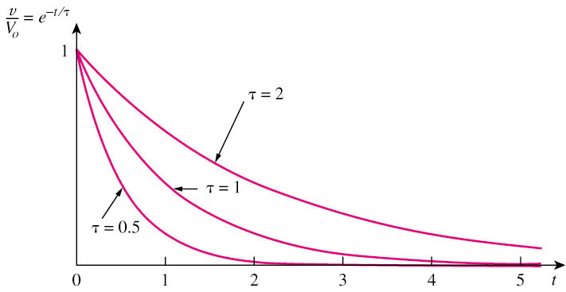
The natural response of a circuit refers to the behavior (in terms of voltages and currents) of the circuit itself, with no external sources of excitation.
where
Time constant
Decays more slowly
Decays faster
The time constant τ of a circuit is the time required for the response to decay by a factor of 1/e or 36.8% of its initial value.
v decays faster for small τ and slower for large τ.

Slide 8
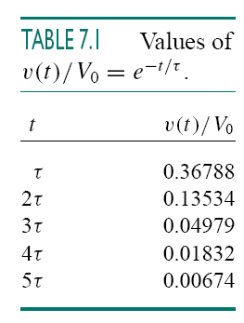
where
It is customary to assume that the capacitor is fully discharged (or charged) after five time constants.
In other words, it takes 5τ for the circuit to reach its final state or steady state when no changes take place with time.

Slide 9
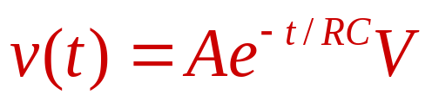
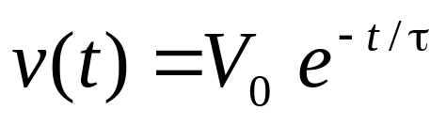
where
The time constant is the same regardless of what the output is defined to be.
How to compute R:the Thevenin equivalent resistance at the terminals of the capacitor(take out the capacitor C and find R = RTh at its terminals).
equivalent capacitor: combined them to form a single.

Slide 10

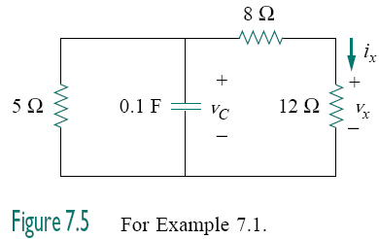
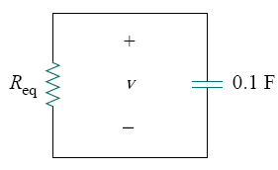






We find the equivalent resistance or the Thevenin resistance at the capacitor terminals.

Slide 11
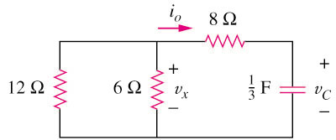
Practice Problem 7.1
Refer to the circuit below, determine v_{C}, v_{x}, and i_{o} for t ≥ 0.
Assume that v_{C}(0) = 30 V.
Answer:
v_{C} = 30e^{–0.25t} V ; v_{x} = 10e^{–0.25t} ; i_{o} = –2.5e^{–0.25t} A

Slide 12

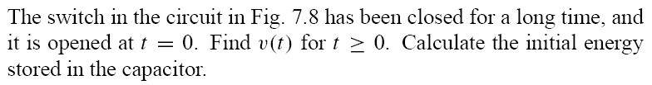
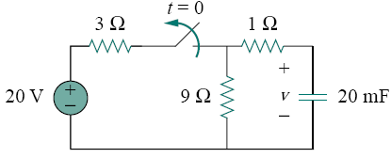
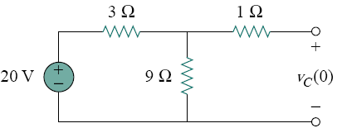




Slide 13
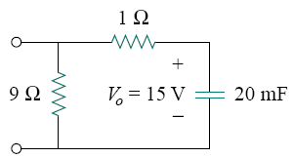





Slide 14
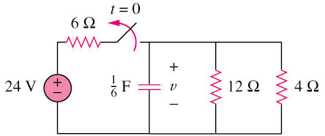
Example 2
The switch in circuit below is opened at t = 0, find v(t) for t ≥ 0.
Answer: V(t) = 8e^{–2t} V

Slide 15
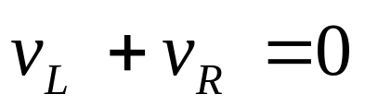
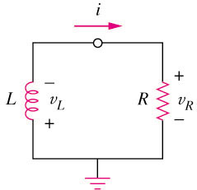
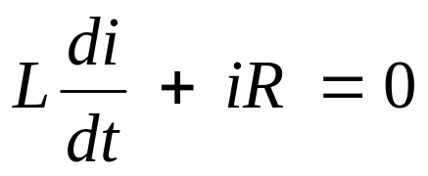
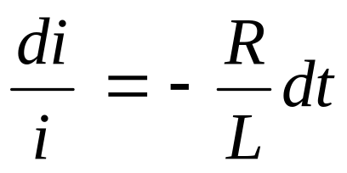
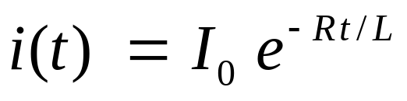
7.2 The Source-Free RL Circuit
A first-order RL circuit consists of a inductor L (or its equivalent) and a resistor (or its equivalent)
By KVL
Inductors law
Ohms law
the natural response of the RL circuit is an exponential decay of the initial current.

Slide 16
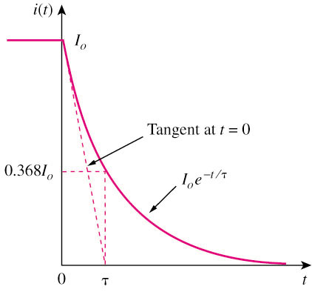

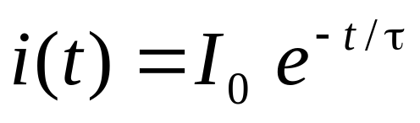
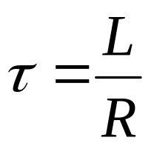
A general form representing a RL
where
The time constant τ of a circuit is the time required for the response to decay by a factor of 1/e or 36.8% of its initial value.
i(t) decays faster for small τ and slower for large τ.
The general form is very similar to a RC source-free circuit.

Slide 17


Comparison between a RL and RC circuit
A RL source-free circuit
A RC source-free circuit
where
where

Slide 18
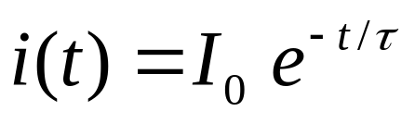
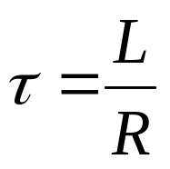
where
The key to working with a source-free RL circuit is finding:
The initial current i(0) = I₀ through the inductor.
The time constant τ = L/R.

Slide 19
where
When a circuit has a single inductor and several resistors and dependent sources, the Thevenin equivalent can be found at the terminals of the inductor to form a simple RL circuit.
Also, one can use Thevenin’s theorem when several inductors can be combined to form a single equivalent inductor.

Slide 20
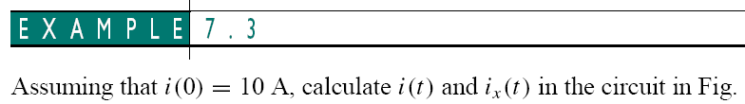
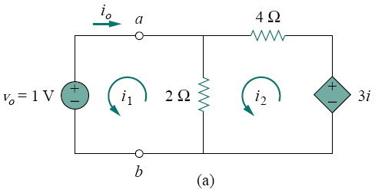
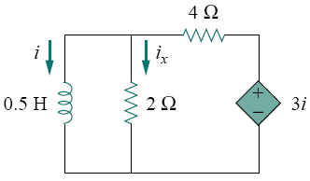







Compute Req ,
Mesh analysis:
So

Slide 21


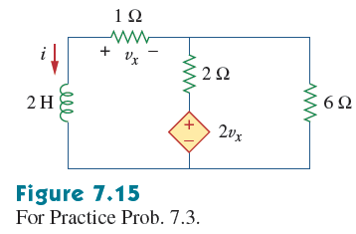


Slide 22
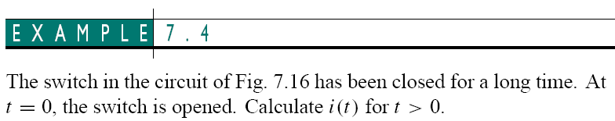
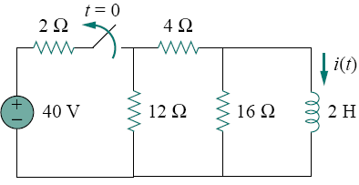
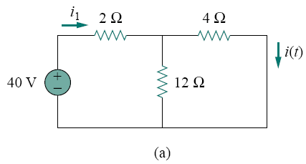





Slide 23
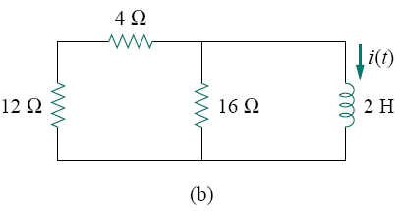






Slide 24
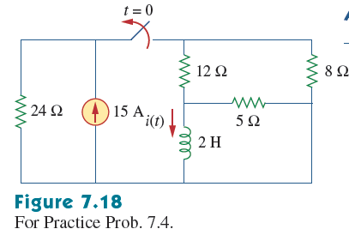


Slide 25

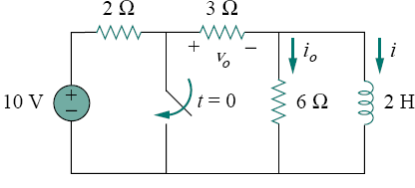
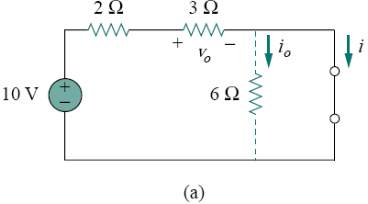
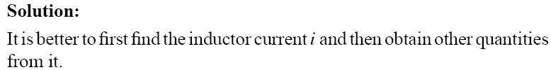




Slide 26
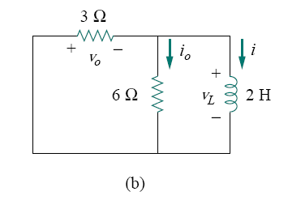






Slide 27
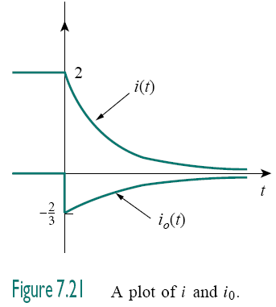
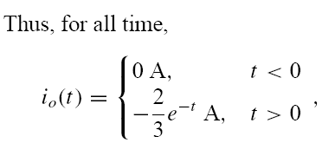



Slide 28
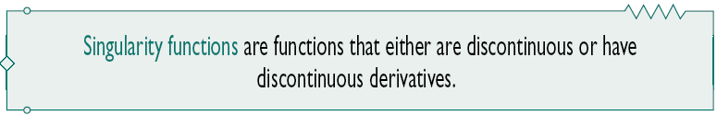
7.4 Singularity functions
The three most widely used singularity functions in circuit analysis are
the unit step,
the unit impulse,
the unit ramp functions.

Slide 29
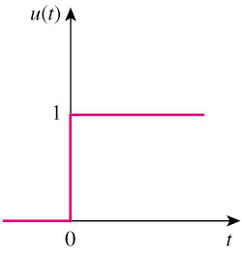
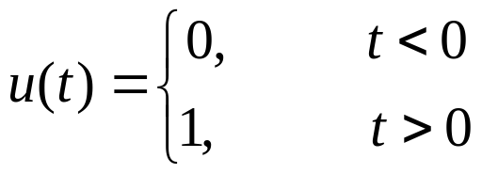
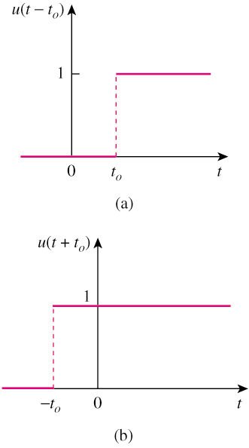


7.4 Singularity functions
The unit step function u(t) is 0 for negative values of t and 1 for positive values of t.

Slide 30


Represent an abrupt change for:
Voltage source.
Current source
switching functions

Slide 31
7.4 The Step-Response of an RC Circuit
When the dc source of an RC circuit is suddenly applied, the voltage or current source can be modeled as a step function, and the response is known as a step response.
The step response of a circuit is its behavior when the excitation is the step function, which may be a voltage or a current source.
The step response is the response of the circuit due to a sudden application of a dc voltage or current source.

Slide 32



7.4 The Step-Response of an RC Circuit
Initial condition:
v(0-) = v(0+) = V₀
Applying KCL,
or
Where u(t) is the unit-step function

Slide 33



Integrating both sides and considering the initial conditions, the solution of the equation is:
Final value at t -> ∞
Initial value at t = 0
Source-free Response
Complete Response = Natural response + Forced Response
(stored energy) (independent source)
= V₀e^{–t/τ} + V_{s}(1–e^{–t/τ})

Slide 34

Three steps to find out the step response of an RC circuit:
The initial capacitor voltage v(0).
The final capacitor voltage v(∞) — DC voltage across C.
The time constant τ.
We obtain item 1 from the given circuit for t < 0 and items 2 and 3 from the circuit for t > 0.
Note: The above method is a short-cut method. You may also determine the solution by setting up the circuit formula directly using KCL, KVL , ohms law, capacitor and inductor VI laws.

Slide 35

the instant when the circuit changes
t=0⁻
0
t=0⁺
the instant just prior to circuit changes Initial state
Only i_{L}(0⁻) or u_{C}(0⁻)
the instant immediately following to circuit changes
Initial value or
Initial condition
y(0⁺) y denote any current or voltage

Slide 36







Slide 37






Slide 38


Example 5
Find v(t) for t > 0 in the circuit in below. Assume the switch has been open for a long time and is closed at t = 0.
Calculate v(t) at t = 0.5.
Answer:
and v(0.5) = 0.5182V

Slide 39








Slide 40






Slide 41








Slide 42




Slide 43



7.5 The Step-Response of a RL Circuit
The step response of a circuit is its behavior when the excitation is the step function, which may be a voltage or a current source.
Initial current
i(0⁻) = i(0⁺) = I_{o}
Final inductor current
i(∞) = V_{s}/R
Time constant τ = L/R

Slide 44

Three steps to find out the step response of an RL circuit:
The initial inductor current i(0) at t = 0+.
The final inductor current i(∞).
The time constant τ.
We obtain item 1 from the given circuit for t < 0 and items 2 and 3 from the circuit for t > 0.
Note: The above method is a short-cut method. You may also determine the solution by setting up the circuit formula directly using KCL, KVL , ohms law, capacitor and inductor VI laws.

Slide 45










Slide 46


Example 6
The switch in the circuit shown below has been closed for a long time. It opens at t = 0.
Find i(t) for t > 0.
Answer:

Slide 47





Slide 48





Slide 49








Slide 50


Slide 51
Summary and Review
The response of a circuit having sources suddenly switched in or out of a circuit containing capacitors and inductors will always be composed of two parts: a natural response and a forced response.
A circuit reduced to a single equivalent inductance L and a single equivalent resistance R will have a natural response given by i(t) = I₀e^{-t/τ}, where τ= L/R is the circuit time constant.

Slide 52
A circuit reduced to a single equivalent capacitance C and a single equivalent resistance R will have a natural response given by v(t) = V₀e^{-t/τ}, where τ= RC is the circuit time constant.
The unit-step function is a useful way to model the closing or opening of a switch, provided we are careful to keep an eye on the initial conditions.
The complete response of an RL or RC circuit excited by a dc source will have the form
y(t) = y(∞) + [y(0⁺) – y(∞)]e^{-t/τ}

Slide 53
Comparison between a RL and RC circuit
A RL source-free circuit
A RC source-free circuit
where
where

Slide 54
Step-Response
v(0-) = v(0+) = V₀
i(0⁻) = i(0⁺) = I_{o}
i(∞) = V_{s}/R
Time constant τ = L/R
v(∞)
=V_{s}

Slide 55


First time assignment

Slide 56


Second time assignment

Slide 57



Slide 58



